Slide 1

INTERIM PROJECT PRESENTATION
Batch: Jan 20, Location: Bangalore
Health Care Analytics – Diabetes Medication Prediction
GROUP - 5
MEMBERS
Veeradhajor
Anurag Sarma
Bonic Sandeep
Lokaram Thabasu
Ashis Kiran
MENTOR: MS AKHILA NAGA SAI GURRE
Great Lakes - Great Learning | Date: 19 NOV 2020

Slide 2
Literature Review
1. Research conducted by S. E. Siegelaar, J. B. L. Hoekstra, and J. H. Devries, “Special considerations for the diabetic patient in the ICU; targets for treatment and risks of hypoglycaemia,” Best Practice and Research: Clinical Endocrinology and Metabolism showed the method of collecting data for diabetes patients.
2. A. G. Pittas, R. D. Siegel, and J. Lau, studied the Insulin therapy for critically ill hospitalized patients showing the combination of drugs for various patients.
3. Research studied by K. J. Cios and G. W. Moore, “Uniqueness of medical data mining” shoed the importance of medical data and handeling of data for research purposes and AI applications.

Slide 3

Problem Statement
The analytics of Health Care data focused on Diabetes patients is highly essential for treatment planning and decision making. The data driven decision making process aids in reliable results bound to the specific credibility of the community.

Slide 4
Objectives
To Predict based on the Patients data the following :
Treat patient with only Insulin
Prescribe combination of drugs along with Insulin

Slide 5
Data Brief
The database includes 4,036,643 unique encounters (visits) that correspond to 17,880,231 unique patients and 2,889,571 providers.
Information was extracted from the database for encounter that satisfied the following criteria
It is an inpatient encounter.
It is a “diabetic” encounter, that is, one during which any kind of diabetes was entered to the system as a diagnosis.
The length of stay was at least 1 day and at most 14 days.
Laboratory tests were performed during the encounter. (5) Medications were administered during the encounter

Slide 6
Key Data Points
Maximum Glucose Serum & HbA1C
Test Results
Age Group, Gender, Patient ID, Race, Weight
Personal Details
Metformin, repaglinide, nateglinide, chlorpropamide,
glimepiride, acetohexamide, glipizide, glyburide, tolbutamide, pioglitazone,
rosiglitazone, acarbose, miglitol, troglitazone, tolazamide, examide, sitagliptin, insulin.
Drugs Prescribed

Slide 7
Exploratory
Data Analytics
Visualizations
Null Values Imputation
Data Architecture
Statistical Test

Slide 8
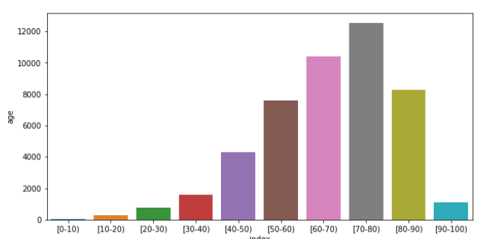
Age Group
The highest no. of patients belonged to the 70 – 80 age group.
The second highest no. of patients were from the 60 – 70 age group followed by 80- 90.
The age group of 0-10 constituted the least patient count.

Slide 9
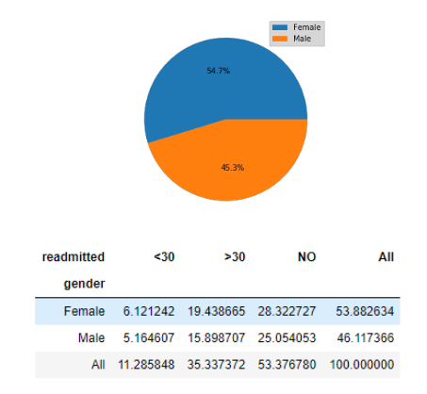
Gender & Re-admission
Females constituting 25.55% showed readmission while only 21% males got
readmitted. ( NO is excluded )

Slide 10
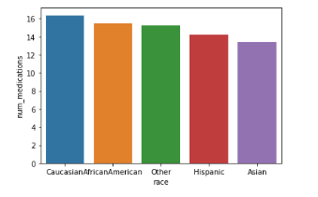
No. of Medications & Race
The Caucasian race was prescribed the highest number of medications followed by African/American race.
The Asians were prescribed the least medications.

Slide 11
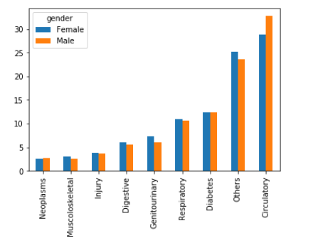
Health Ailments & Gender
The highest diagnosis was Circulatory and male were higher in counts for the same.
In terms of diabetes, the gender distribution is visually equal.

Slide 12
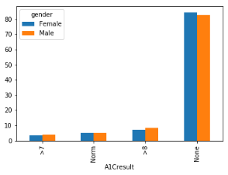
HbA1C Result & Gender
Of the patients with A1C results dropping ‘None’, Male patients had higher count compared to females with A1C score greater than 8.
In case of A1C results greater than 7, males count were higher than females.

Slide 13
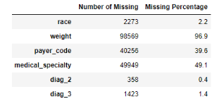
Null Values Imputation
Features Removed
The features with more than 30 percent of null values are eliminated. (weight, payer code and medical specialty)
Observation Deleted
The feature gender and race has minimal number of null values. So, the observations are deleted
as it doesn’t incur any data loss.
Zero Imputed
The features diag_2 and diag_3 are categorical variables. As they denote the diagnosis variable, no other imputation is possible other than imputing it with zero. So, the null
values are imputed with 0.

Slide 14
Architecture
Diagnosis Coding
The alpha numeric coding of the diagnosis was converted to numeric by eliminating the prefix alphabets.
The coding of diseases was converted to names of diagnosis. If condition was used and the coding was provided. For example, coding between 390 to 458 was coded as ‘Circulatory’

Slide 15
Architecture
Age Buckets
Age was bucketed and converted to groups namely child, adult and seniors. The age group was converted based on the age buckets provided below:
0 to 20 : Child
20 to 60: Adult
60 to 100 :Seniors

Slide 16
A1C and Readmitted
Converted to Categories
The A1C result above 7 and 8 were coded as ‘Not Normal’.
The column included the following Not Normal, Normal and None after the procedure.
The readmission column was coded as ‘Yes’ and ‘No’ with patients readmitted >30 or <30 days as ‘Yes’ and patients not admitted as ‘No’.

Slide 17
Target Variable Initiation
Based on the data from the 24 different medications in the dataset, If the patient was prescribed only insulin it was coded as ‘Only Insulin’ and if the patient was prescribed Insulin along with any other medication it was coded as ‘Combination of Drugs’.
Name of Column : Target
Classification in Target Variable: Only Insulin, Combination of Drugs

Slide 18
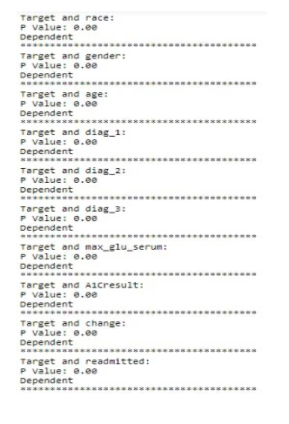
Statistical Test
The results obtained from the python code for loop shows that race, gender, age, diag_1, diag_2, diag_3, max_glu_serum, A1Cresult, Change, Readmitted are all dependent to the Target variable as the P-Value in all the cases are less than the critical value of 0.05

Slide 19
Feature Engineering
Variance Inflation Factory (VIF)
A variance inflation factor(VIF) detects multicollinearity. Multicollinearity is when there’s correlation between predictors in a model; it’s presence can adversely affect your regression results. The VIF estimates how much the variance of a regression coefficient is inflated due to multicollinearity in the model.
In this part, the VIF for all the columns were calculated using the Variance_inflation_factor from the statsmodels library.
The threshold is set as 5, since it has many columns. None of the columns have VIF more than 3. So not deleted any column based on VIF. Hence no column has been dropped and it shows there is no multicollinearity in the dataset.

Slide 20
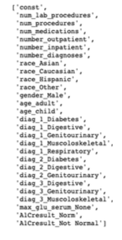
Feature Engineering
Backward Elimination
Selected 27 Columns
Backward elimination is a feature selection technique while building a machine learning model. It is used to remove those features that do not have a significant effect on the dependent variable or prediction of output.
Number of columns before Backward Elimination: 46
Number of Columns after Backward Elimination: 27

Slide 21
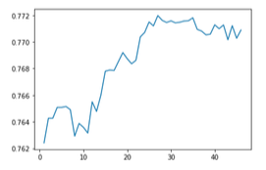
Feature Engineering
RFE (Recursive Feature Elimination) Method
Accuracy Against No. of Columns
RFE works by searching for a subset of features by starting with all features in the training dataset and successfully removing features until the desired number remains. This is achieved by fitting the given machine learning algorithm used in the core of the model, ranking features by importance, discarding the least important features, and re-fitting the model. This process is repeated until a specified number of features remains
It is visible from the graphical representation above, the peaks at which the highest accuracy were attained. Results with 27 columns presented highest accuracy
The highest accuracy determined was 0.77 or 77%

Slide 22
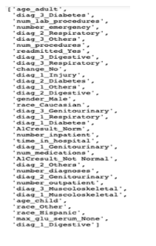
Feature Engineering
Final Feature Selection
Final Selected 37 Columns (Features)
The final columns or features were selected based on 3 parameters:
1. Full grown decision tree
2. RFE method
3. P-Value
The features from the Decision Tree (30 columns) were selected and the features that are in the RFE selection but not in the decision tree were also added.
Further, the columns from RFE were evaluated to the p-value.
The features with high p-value in col_1 were selected. The total count of selected features were 37.

Slide 23
MODEL RESULTS- AUC
logistic | RandomForest | AdaBoost+DT | AdaBoost+LR | AdaBoost+RF | KNN | Naive base | LGBM | GradientBoost | XGboost | (AdaBoost+RF)(LGBM)(GdB) | (AdaBoost+RF)(LGBM) | (AdaBoost+RF)(GdB)
0.837005 | 0.835962 | 0.827886 | 0.835949 | 0.839538 | 0.814917 | 0.822932 | 0.839992 | 0.839283 | 0.839492 | 0.840199 | 0.840216 | 0.839696
0.828109 | 0.834894 | 0.819891 | 0.823878 | 0.83464 | 0.803795 | 0.813205 | 0.83649 | 0.837011 | 0.835396 | 0.837241 | 0.836652 | 0.837121
0.840946 | 0.840043 | 0.827704 | 0.83557 | 0.851186 | 0.818698 | 0.822624 | 0.848295 | 0.846407 | 0.844279 | 0.848287 | 0.849003 | 0.847399
0.833736 | 0.835449 | 0.825923 | 0.830302 | 0.835824 | 0.811765 | 0.811493 | 0.83865 | 0.835826 | 0.833356 | 0.838038 | 0.838718 | 0.836522
0.841065 | 0.844634 | 0.831221 | 0.840279 | 0.849499 | 0.813996 | 0.824152 | 0.847226 | 0.847273 | 0.84637 | 0.848942 | 0.847921 | 0.847965
0.8309 | 0.837485 | 0.824561 | 0.831111 | 0.844757 | 0.805807 | 0.818925 | 0.842837 | 0.8412 | 0.836847 | 0.842877 | 0.843399 | 0.842052
0.82843 | 0.833489 | 0.818855 | 0.829698 | 0.836828 | 0.808668 | 0.818024 | 0.836322 | 0.836632 | 0.837661 | 0.837302 | 0.836891 | 0.837015
0.821839 | 0.825887 | 0.8171 | 0.819521 | 0.831925 | 0.797706 | 0.804489 | 0.830795 | 0.831301 | 0.827606 | 0.831942 | 0.831421 | 0.83178
0.850272 | 0.850079 | 0.835772 | 0.846698 | 0.852852 | 0.830048 | 0.828593 | 0.855245 | 0.853804 | 0.85569 | 0.855605 | 0.855518 | 0.854229
0.828215 | 0.833148 | 0.821163 | 0.825762 | 0.838713 | 0.809179 | 0.812717 | 0.838146 | 0.836638 | 0.838111 | 0.837983 | 0.838512 | 0.837137

Slide 24
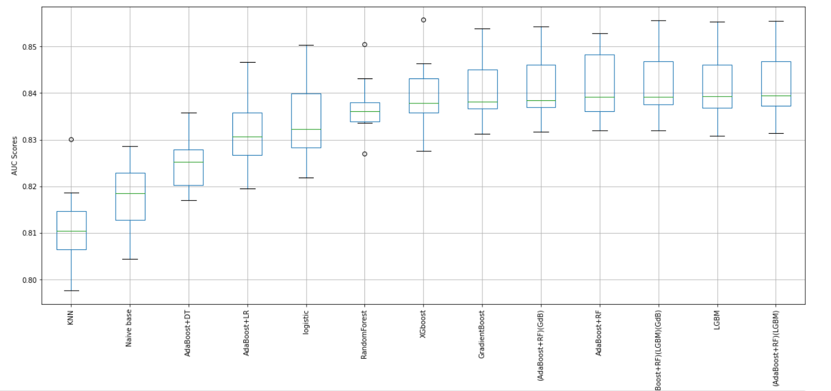
5.7.2 All Models AUC Score Box Plot:

Slide 25
MODEL RESULTS- AUC (summary)
Models | AUC | accuracy | f1_weighted | precision | recall
logistic | 0.834052 | 0.755928 | 0.755481 | 0.886031 | 0.654536
RandomForest | 0.837107 | 0.757491 | 0.755854 | 0.909877 | 0.636589
AdaBoost+DT | 0.825008 | 0.748581 | 0.747785 | 0.884539 | 0.641143
AdaBoost+LR | 0.831877 | 0.752995 | 0.753746 | 0.849057 | 0.687347
AdaBoost+RF | 0.841576 | 0.761137 | 0.761364 | 0.874755 | 0.676354
KNN | 0.811458 | 0.734243 | 0.735142 | 0.825659 | 0.674615
Naive base | 0.817715 | 0.737642 | 0.729649 | 0.987013 | 0.545309
LGBM | 0.8414 | 0.761192 | 0.76125 | 0.879551 | 0.671537
GradientBoost | 0.840537 | 0.761082 | 0.760874 | 0.882399 | 0.668428
XGboost | 0.839481 | 0.759355 | 0.759407 | 0.877567 | 0.669826
(AdaBoost+RF)(LGBM)(GdB) | 0.841842 | 0.761877 | 0.761736 | 0.881564 | 0.670825
(AdaBoost+RF)(LGBM) | 0.841825 | 0.761274 | 0.761353 | 0.879139 | 0.672119
(AdaBoost+RF)(GdB) | 0.841092 | 0.761329 | 0.761303 | 0.881877 | 0.669193

Slide 26
Model Selection
 | Mean AUC | Bias | variance | coefficient of variation | Time in SEC
logistic | 0.834052 | 0.165948 | 0.008358 | 99.79261 | 0.204
RandomForest | 0.837107 | 0.162893 | 0.006644 | 125.9941 | 3.73
AdaBoost+DT | 0.825008 | 0.174992 | 0.005892 | 140.0301 | 0.39
AdaBoost+LR | 0.831877 | 0.168123 | 0.008044 | 103.4152 | 0.99
AdaBoost+RF | 0.841576 | 0.158424 | 0.007466 | 112.7256 | 43.1
KNN | 0.811458 | 0.188542 | 0.008877 | 91.40965 | 73
Naive base | 0.817715 | 0.182285 | 0.007239 | 112.9613 | 0.0364
LGBM | 0.8414 | 0.1586 | 0.007131 | 117.9842 | 1.79
GradientBoost | 0.840537 | 0.159463 | 0.006735 | 124.7995 | 18.4
XGboost | 0.839481 | 0.160519 | 0.00775 | 108.3225 | 2.32
(AdaBoost+RF)(LGBM)(GdB) | 0.841842 | 0.158158 | 0.007105 | 118.4895 | 63
(AdaBoost+RF)(LGBM) | 0.841825 | 0.158175 | 0.007159 | 117.5949 | 46
(AdaBoost+RF)(GdB) | 0.841092 | 0.158908 | 0.006816 | 123.4018 | 61

Slide 27
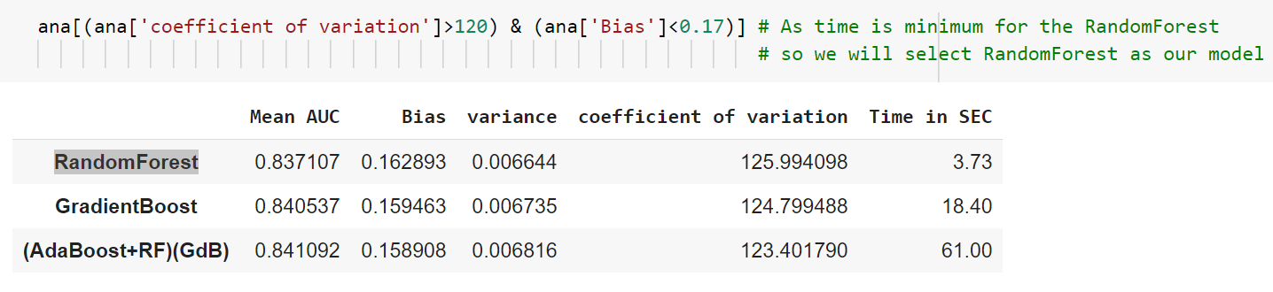
Model Selection

Slide 28
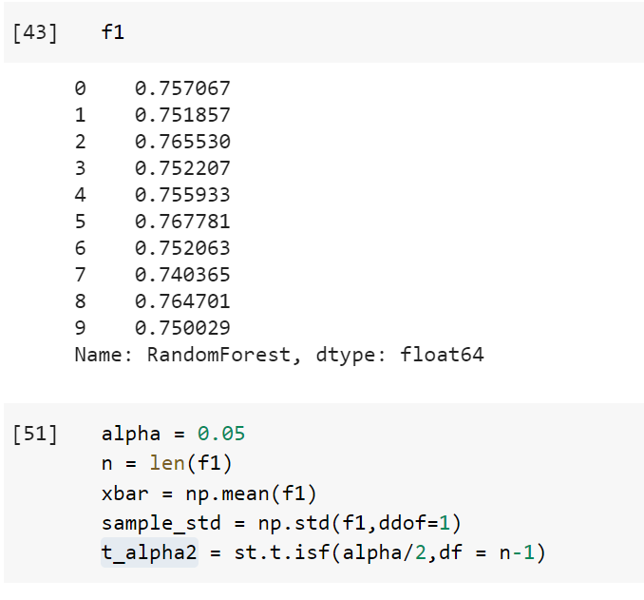
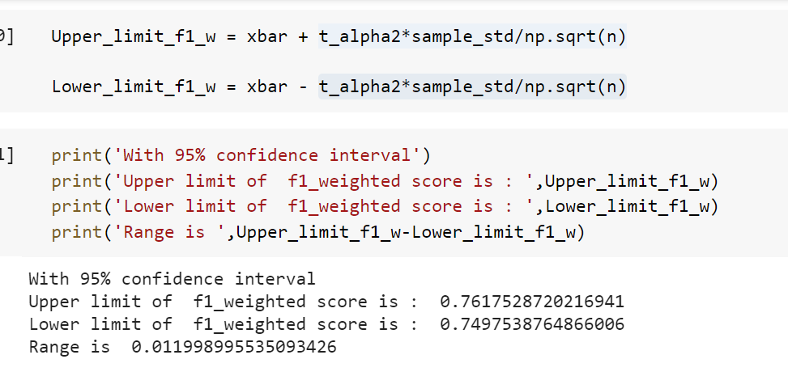
RESULTS:

